Slide 1
Healthcare Metrics Project
by: Farzad Radmehr

Slide 2
Missing Values, duplicates and outliers information
Missing values, duplicates and outliers information is presented for each csv files
To detect outliers in the files, we used 3 standard deviation approach, which calculates average +/- 3std for each column; if we have values outside of this range; it’s going to be an outlier.
Python code is presented in the project (3. Initial Data Analysis.ipynb)

Slide 3
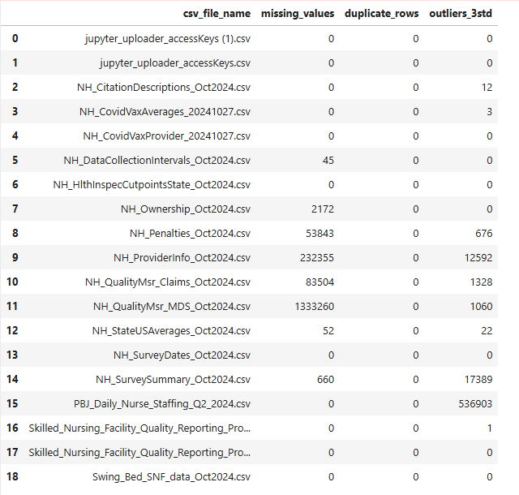

Slide 4
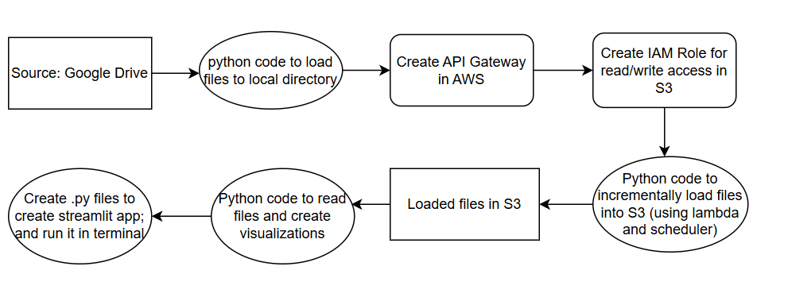
Data Architecture
End to End steps from data ingestion to creating Steamlit app:

Slide 5
Step by step process of creating the pipeline
Set up AWS connections using API gateway, IAM roles and policies, Lambda and S3 bucket.
Read files from google drive and incrementally loaded into S3 by using a python code (2. csv into S3-ELT.ipynb) and AWS credentials from step 1.
Upload files from S3; and run python code (3. Initial Data Analysis.ipynb) to create the visualizations.
Create streamlit app code (dashboard.py)
Save it in local directory and use below commands in the terminal:
cd <local directory that contains the streamlit app code>
Run: streamlit run dashboard.py
The final streamlit url will open (4. Streamlit dashboard presentation)

